Slide 1
Department of Environmental Quality
Interbasin Transfer Program Update
Water Allocation Committee January 13, 2016

Slide 2
Proposed Project Description
Primary Applicant: | Union County
Source Basin: | Yadkin
Receiving Basin: | Rocky
Grandfathered Allowance: | N/A
Total Requested IBT (2050 Demands): | 23 MGD (avg day/max mth)
New Certificate, following G.S. 143-215.22L(c-n)
Department of Environmental Quality

Slide 3
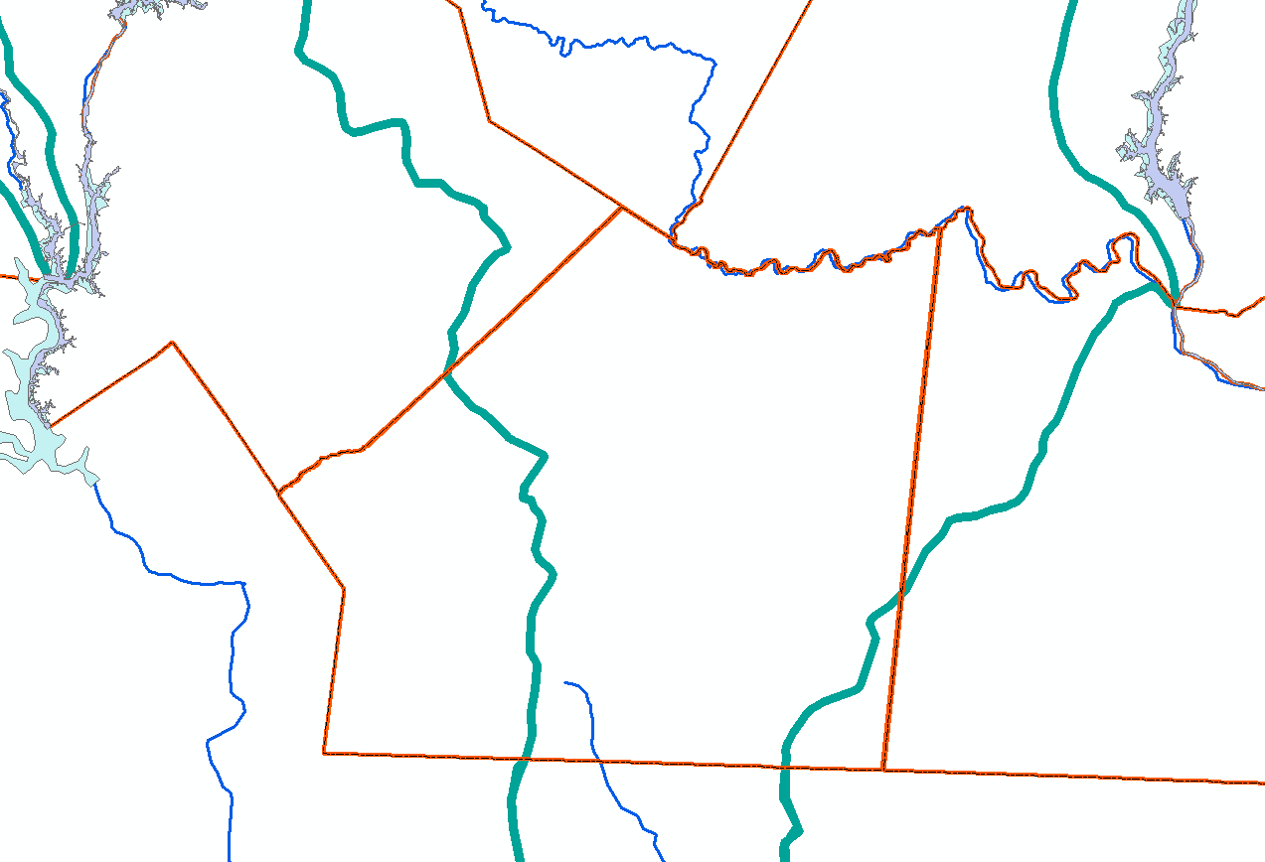
Lake Tillery
Cabarrus
Stanly
Norwood
Catawba River Basin
Mecklenburg
Proposed 23.0 mgd IBT: Yadkin to Rocky
Union
Monroe
Yadkin River Basin
Rocky River Basin
South Carolina
Existing 5.0 mgd Grandfathered IBT: Catawba to Rocky
Anson

Slide 4
IBT Process § 143-215.22L
✓ I. Applicant submits Notice of Intent to file a petition.
30 days notice of public meetings
3+ Public meetings
➔ II. Applicant submits draft environmental document (EIS or EA)
30 days notice of public hearing
EMC public hearing
Sept. 16, 2015
Comments accepted for 30 days after hearing
EMC prepares written response to comments
Adequacy of environmental document determined
Settlement discussions, if requested
III. Applicant submits petition to EMC
EMC issues Draft Determination within 90 days of receiving petition and adequacy of doc determined
Public notice of draft determination and 30-day notice of hearings
2+ public hearings held within 60 days of issuing draft determination
Comments accepted for 30 days after last hearing
EMC prepares written response to comments
EMC issues final determination

Slide 5
Public Hearing & Comments on draft EIS
Public hearing held September 16, 2015
Comments received through November 16, 2015 (after 30-day extension)
Eight speakers at public hearing
Eight written comments
Response to written comments included as appendix to EIS

Slide 6
Summary of Public Comments on Draft EIS
Concern about impact that withdrawals from Lake Tillery will have on downstream users, especially during drought conditions, now and in future
Union County urged to collaboratively develop a plan increasing protection and restoration of Lake Tillery to strengthen source water protection
The projected growth rate and need for water were questioned
Questioned the selection of 1A as the preferred alternative

Slide 7
Contact Information
Kim Nimmer
NCDEQ - Division of Water Resources
kim.nimmer@ncdenr.gov
919-707-9019
Department of Environmental Quality

